Slide 1

Let’s start with Allah Yaar
Bs in Computer Science

Slide 2
ICT (Information and Communication Technologies)
Information and Communication Technologies
Define:
Can be broadly defined as the means of creation, storage, management and dissemination of information by electronic means.
Those technologies that enable the handling of information and facilitate different forms of communication.

Slide 3
Physical Components of Computer Systems
The physical components of a computer, also called hardware
Central Processing Unit (CPU)
Memory (RAM)
Storage Devices
Input Devices
Output Devices
Motherboard
Power Supply

Slide 4
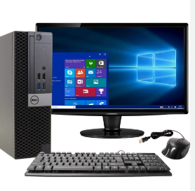
Desktop Computers
Desktop computers are personal computers designed primarily for use at a fixed location, typically on a desk. These systems are built for versatility, allowing users to perform a variety of tasks, from simple data entry and office applications to multimedia processing and gaming.

Slide 5
Desktop Computers
Components:
Central Processing Unit (CPU) (The "brain" of the computer, typically housed in a large tower or compact case. It handles processing and coordinates between the different parts of the computer.)
Monitor (The display screen, usually larger than a laptop screen, offering a better view for detailed tasks like graphic design or programming.)
Input Devices (Standard devices include a keyboard for typing and a mouse for navigation. Additional peripherals, like scanners and printers, can also be connected)

Slide 6
Desktop Computers
Components
Storage (Generally has larger internal storage than portable devices, usually in the form of hard disk drives (HDDs) or solid-state drives (SSDs))

Slide 7
Uses of Desktop Computers
Use:
Home Use (Ideal for internet browsing, document editing, streaming, and gaming.)
Office Work (Used in businesses for tasks such as word processing, spreadsheets, and presentations)
Creative and Professional Use (Frequently used by graphic designers, video editors, and architects due to their high processing power and large display screens)

Slide 8
Mobile Computers
Mobile computers are portable and designed to be carried from place to place. They are pSmartphonesopular because they offer flexibility, convenience, and connectivity on the go.
Types of Mobile Computers
Laptops
Tablets
Smartphones

Slide 9
Mobile Computers
Types of Mobile Computers
Laptops
Portable computers with all components—keyboard, display, storage, and CPU—integrated into one unit.
Advantages (Portability, battery-powered, and powerful enough for various tasks from browsing to programming and creative work.)
Uses (Commonly used by students, business professionals, and remote workers who need a balance between performance and portability.)

Slide 10
Mobile Computers
Types of Mobile Computers
Tablets
Lightweight, touchscreen devices usually running a mobile operating system (e.g., iOS or Android)
Advantages (Easy to carry, touch-sensitive screens, and typically long battery life.)
Uses (Primarily for media consumption (vreading, watching ideos), casual browsing, and light productivity tasks. Some tablets come with detachable keyboards, allowing for more traditional typing when needed.)

Slide 11
Mobile Computers
Types of Mobile Computers
Smartphones
Compact handheld devices with significant processing power, communication capabilities, and internet access.
Advantages (Always connected, highly portable, and packed with features like GPS, cameras, and sensors.)
Uses (Ideal for communication, social media, photography, GPS navigation, and accessing information quickly.)

Slide 12
Mainframes
Mainframes are large, powerful computers used by big organizations to process extensive amounts of data and handle large volumes of transactions simultaneously. They are built for reliability, scalability, and robustness, allowing them to run critical applications continuously without failure.
Key Characteristics:
High Processing Power (Capable of executing thousands of transactions per second, making them ideal for operations that require intense computational power)
Large Storage Capacity (Mainframes can store and manage vast amounts of data, essential for handling complex databases or processing records.)

Slide 13
Mainframes
Multi-user Support (They support hundreds or even thousands of simultaneous users, each accessing the system for different tasks)
Reliability and Security (Mainframes are known for high reliability, as they are built to run continuously and ensure secure data handling, which is critical for financial institutions and government bodies)

Slide 14
Mainframes
Uses
Banking (Processing large numbers of financial transactions, such as ATM withdrawals, account management, and loan processing)
Government and Public Administration (public records management, and secure handling of sensitive data)
Retail and Airlines (Used for managing customer data, reservations, and point-of-sale systems in real-time.)

Slide 15
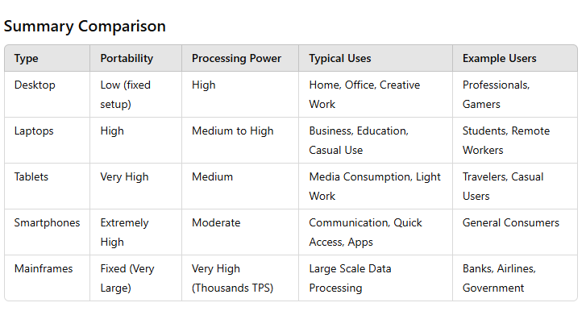
Mainframes

